Slide 1
NTU-IBM Q System 2020 Q-Camp:
Quantum Pattern Matching
ISSUE: #16
Coach: Che Chiang
Date: Sep 10th, 2020

Slide 2
Outline
Problem Definition
D-dimensional Pattern Matching
To find a target pattern of length m^{d} within a text of length n^{d}.
Main Demonstration
A. Brute-Force Grover’s Algorithm
B. Quantum Pattern-Matching Algorithm for multiple pattern (Dan Ventura and Tony Martinez, 1998)

Slide 3
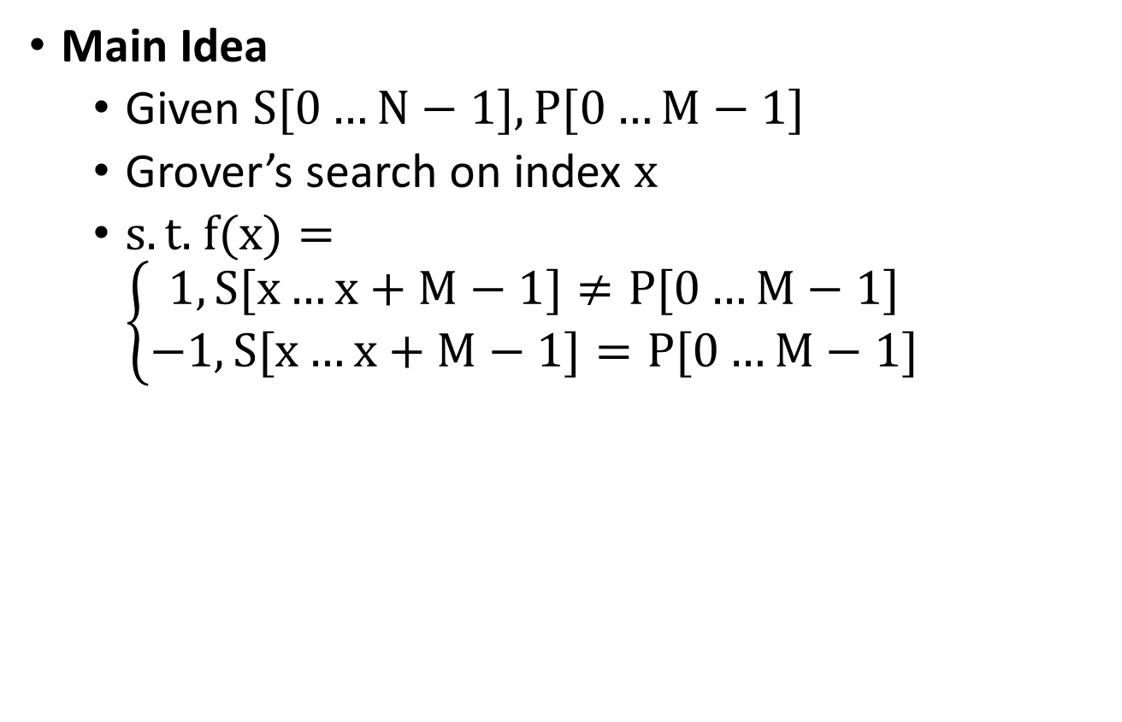
Brute-Force Grover’s Algorithm
Main Idea
Given $S[0…N−1], P[0…M−1]$
Grover’s search on index $x$
$s.t.$ $f(x)=\left\{\begin{aligned}1, S[x…x+M−1]≠P[0…M−1] \\ −1, S[x…x+M−1]=P[0…M−1]\end{aligned}\right.$

Slide 4




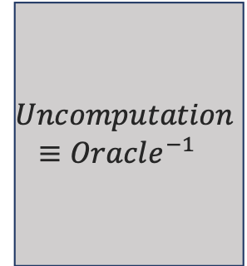
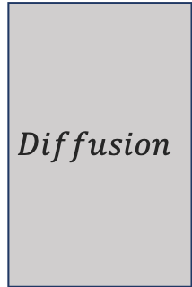
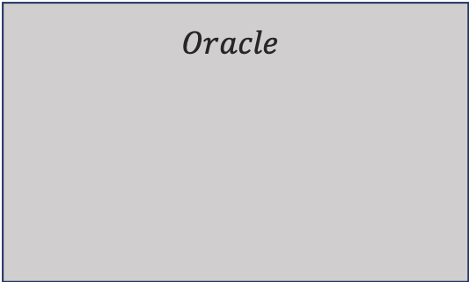
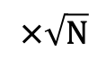
Brute-Force Grover’s Algorithm
Architecture
$$Initialization$$
$$Grover Iterator$$
$$Oracle$$
$$Uncomputation$$
$$≡Oracle^{−1}$$
$$Diffusion$$
$$Shift$$
$$Equality$$
$$Check$$
$$×\sqrt{N}$$

Slide 5

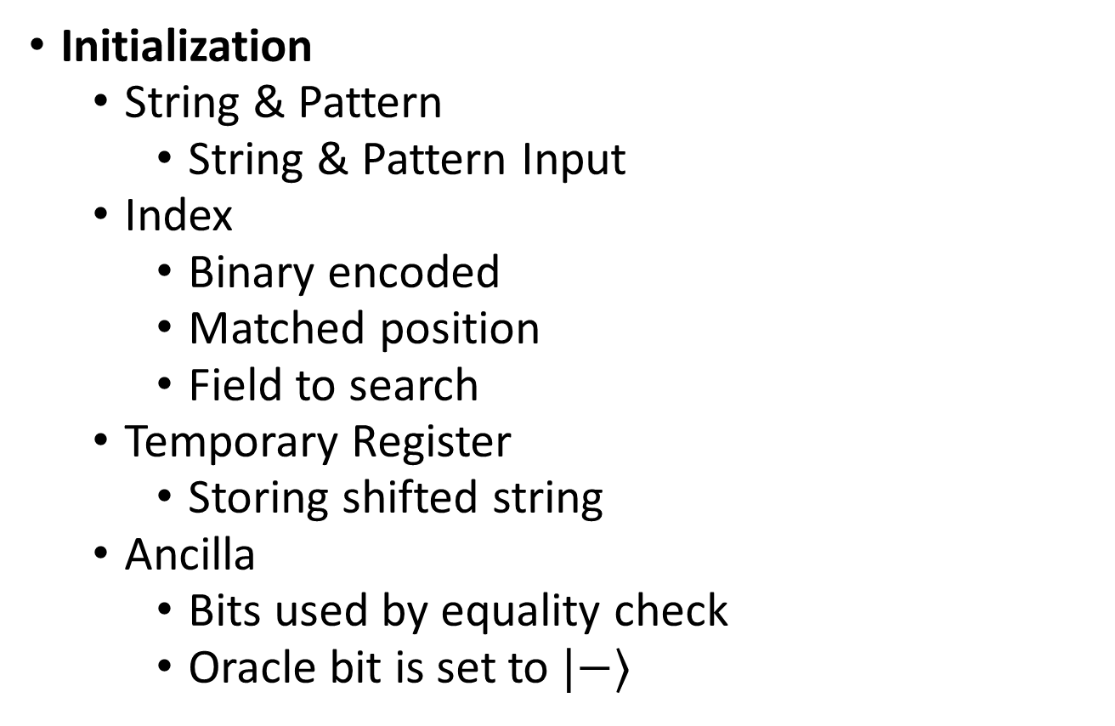





Brute-Force Grover’s Algorithm
Initialization
String & Pattern
String & Pattern Input
Index
Binary encoded
Matched position
Field to search
Temporary Register
Storing shifted string
Ancilla
Bits used by equality check
Oracle bit is set to $|−⟩$
$$Initialization$$
$$String$$
$$Temporary$$
$$Pattern$$
$$Index$$
$$Ancilla$$

Slide 6

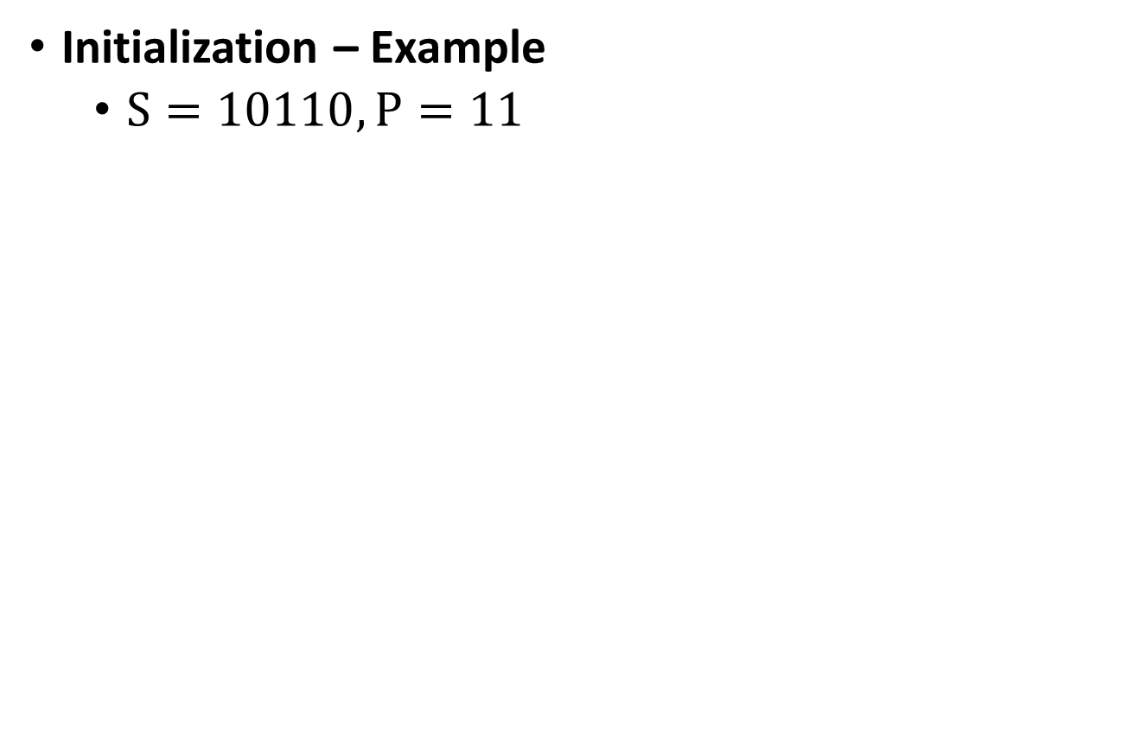





Brute-Force Grover’s Algorithm
Initialization – Example
$S=10110, P=11$
$$Initialization$$
$$String$$
$$Temporary$$
$$Pattern$$
$$Index$$
$$Ancilla$$

Slide 7
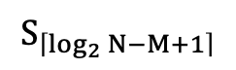

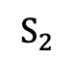
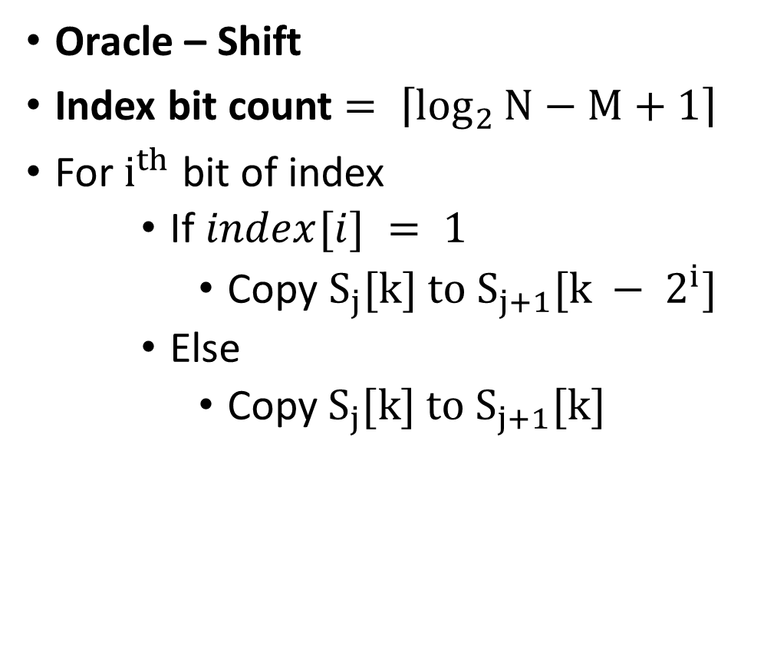
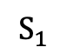
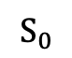

Brute-Force Grover’s Algorithm
Oracle – Shift
Index bit count $= \left\lceil \log_{2}{N−M+1}\right\rceil$
For $i^{th}$ bit of index
If $index[i] = 1$
Copy $S_{j}[k] to S_{j+1}[k − 2^{i}]$
Else
Copy${ S}_{j}[k] to S_{j+1}[k]$
$$S_{0}$$
$$String$$
$$S_{1}$$
$$Temporary$$
$$S_{2}$$
…
$$S_{\left\lceil \log_{2}{N−M+1}\right\rceil }$$

Slide 8
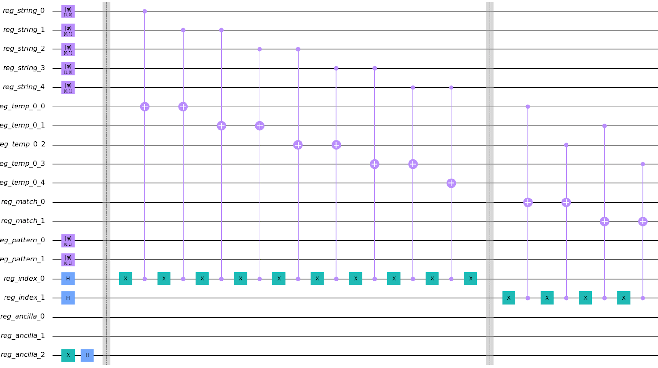
Brute-Force Grover’s Algorithm
Oracle – Shift – Example

Slide 9
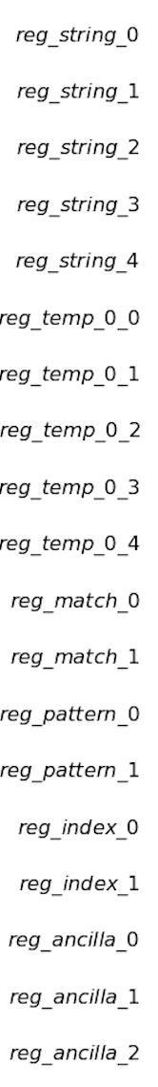
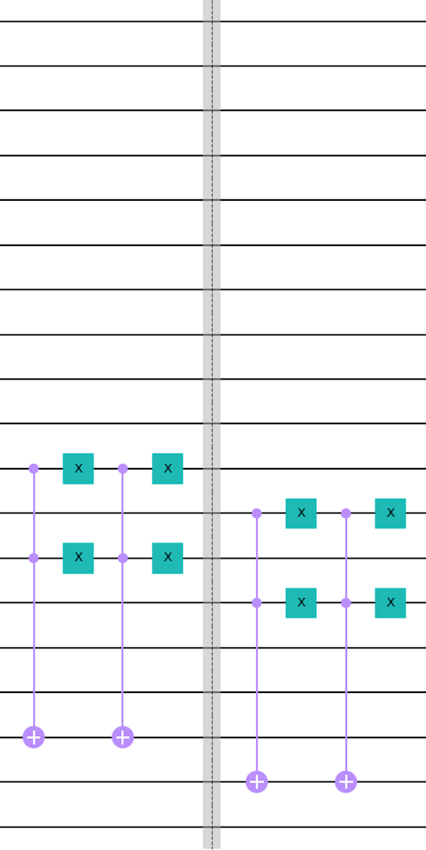
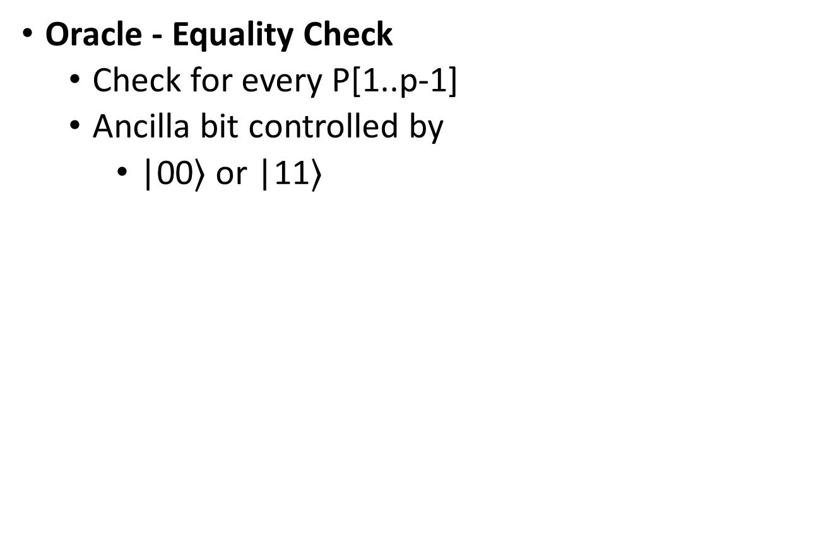
Brute-Force Grover’s Algorithm
Oracle - Equality Check
Check for every P[1..p-1]
Ancilla bit controlled by
|00$⟩$ or |11$⟩$

Slide 10
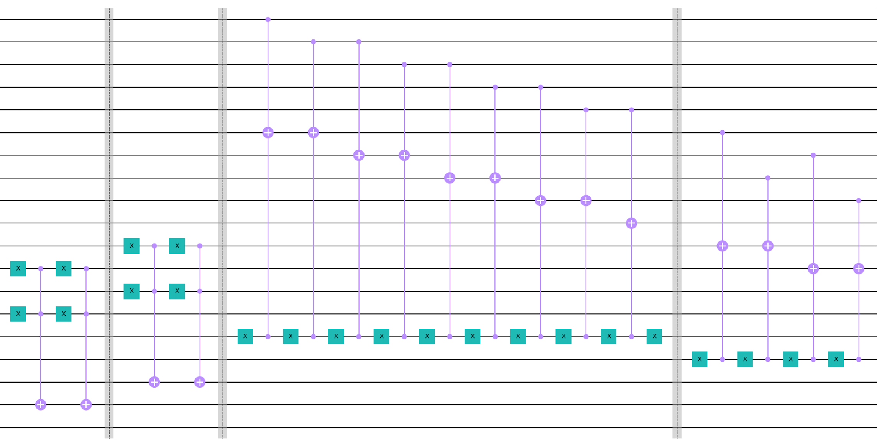
Brute-Force Grover’s Algorithm
Uncomputation
Simply Reverse the Oracle

Slide 11
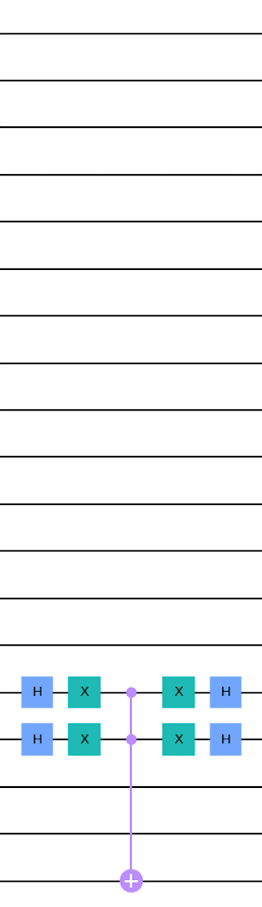
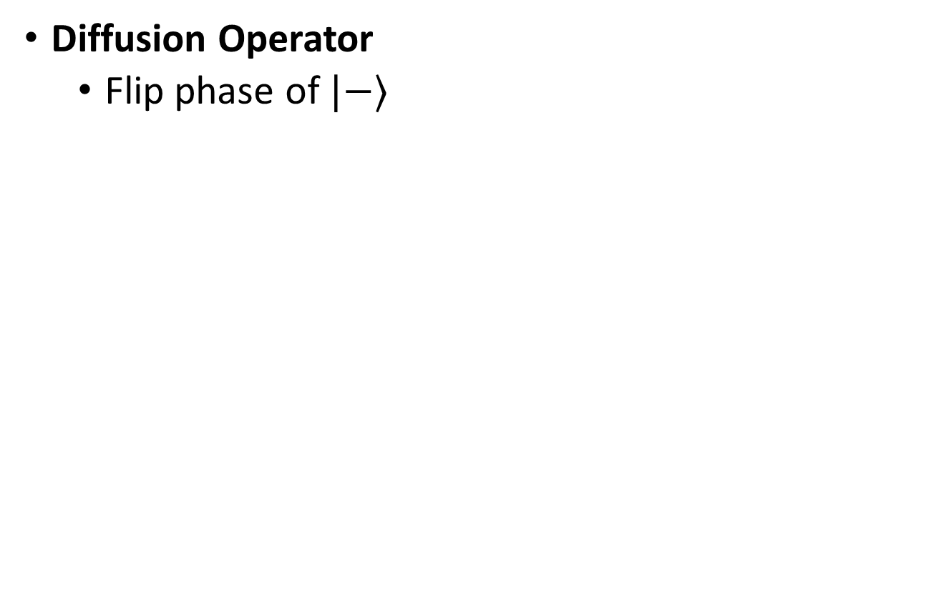
Brute-Force Grover’s Algorithm
Diffusion Operator
Flip phase of $|−⟩$

Slide 12
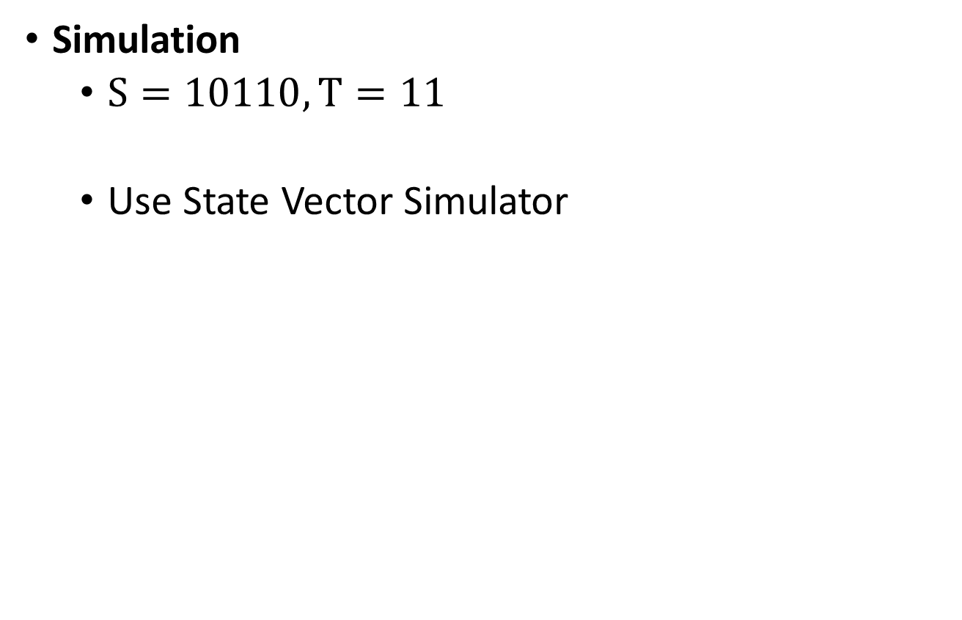
Brute-Force Grover’s Algorithm
Simulation
$S=10110, T=11$
Use State Vector Simulator
0 1 2 3

Slide 13
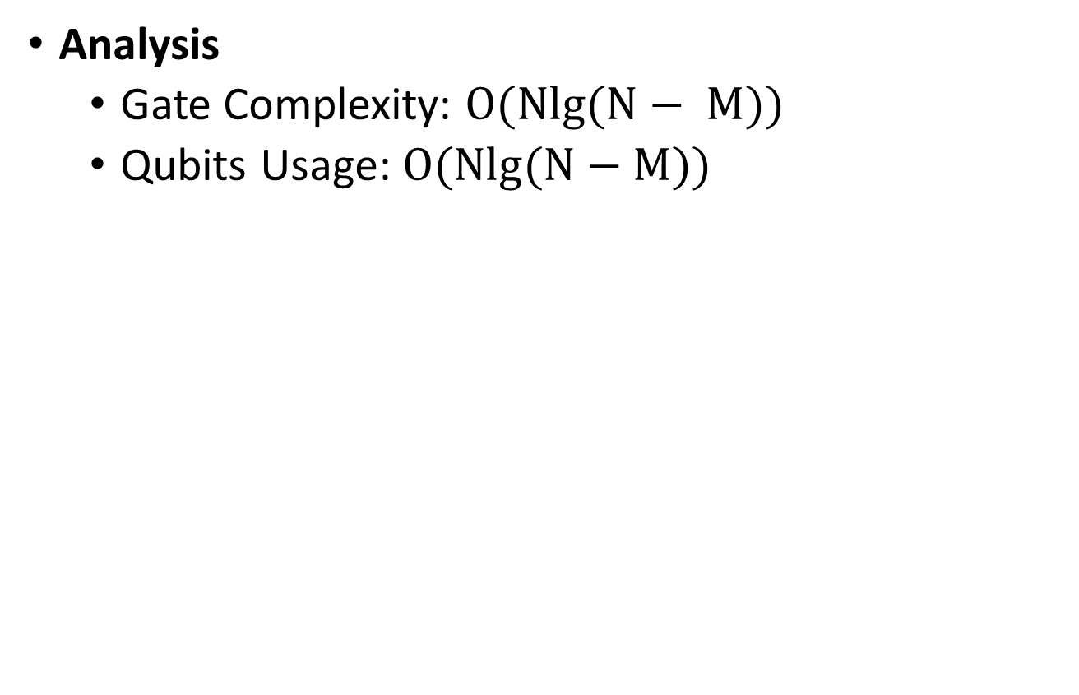
Brute-Force Grover’s Algorithm
Analysis
Gate Complexity: $O(Nlg(N− M))$
Qubits Usage: $O(Nlg(N−M))$

Slide 14
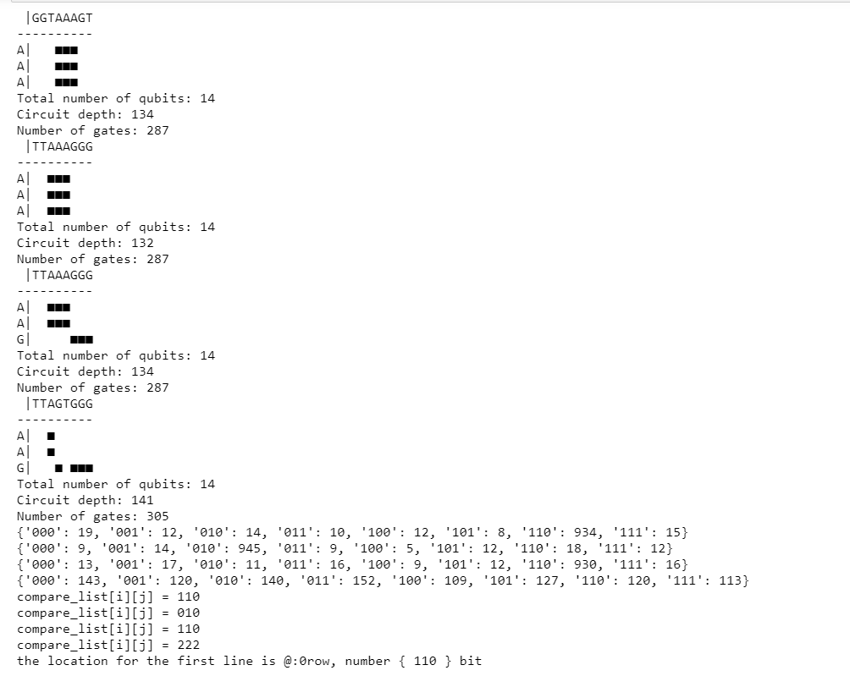
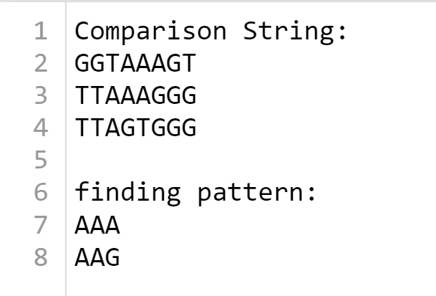
2-D Quantum Pattern Matching
Pattern String and Probabilities Result
Find out the
Matching pattern
Existing Location
Result Location: first line {110}bit
Code for 2D Quantum Pattern Matching is available on:
git@github.com:Yi-Huaaa/2D-pattern-Matching.git

Slide 15
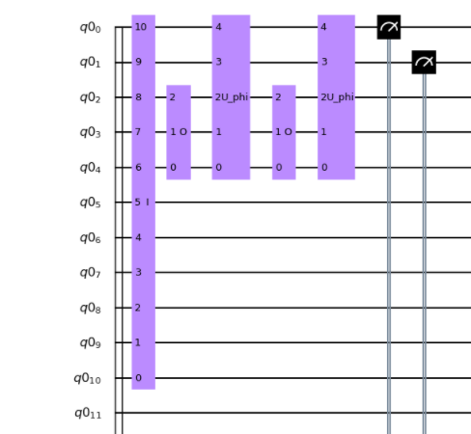
Quantum Circuit

Slide 16
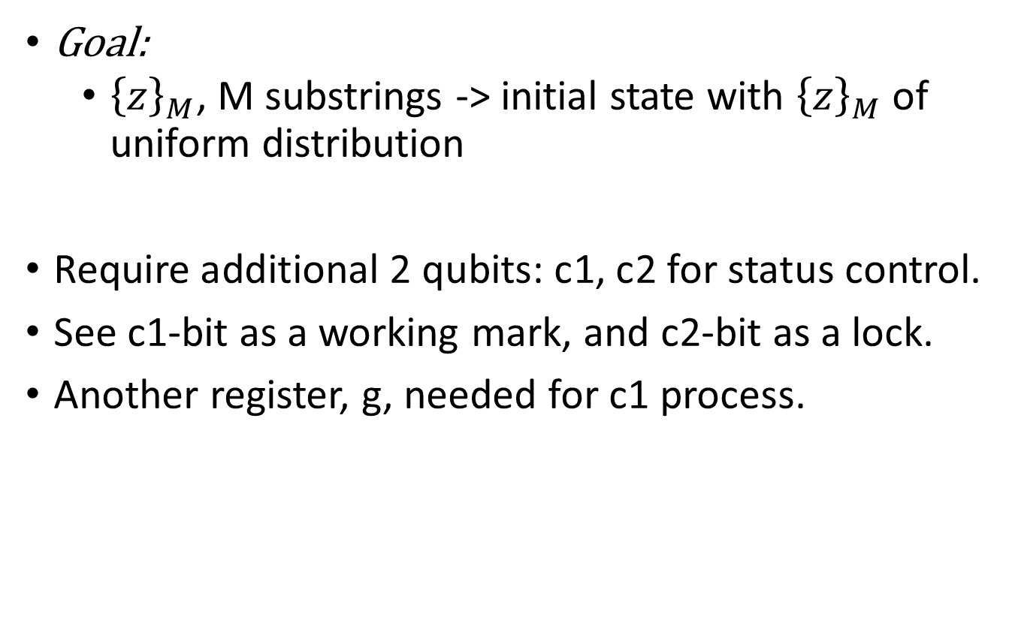
Initial State Generating
Goal:
${\left\{z\right\}}_{M}$, M substrings -> initial state with ${\left\{z\right\}}_{M}$ of uniform distribution
Require additional 2 qubits: c1, c2 for status control.
See c1-bit as a working mark, and c2-bit as a lock.
Another register, g, needed for c1 process.

Slide 17

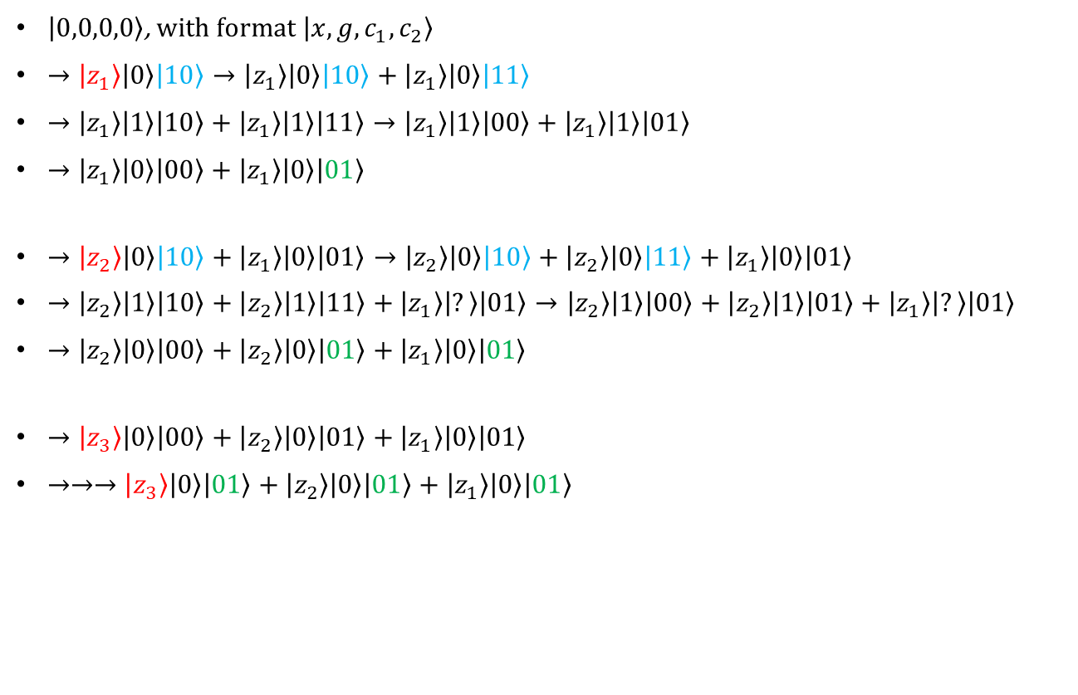
Initial State Generating
$\left|0,0,0,0\right\rangle$, with format $\left|x, g, c_{1}, c_{2}\right\rangle$
$→\left|z_{1}\right\rangle \left|0\right\rangle \left|10\right\rangle →\left|z_{1}\right\rangle \left|0\right\rangle \left|10\right\rangle +\left|z_{1}\right\rangle \left|0\right\rangle \left|11\right\rangle$
$→\left|z_{1}\right\rangle \left|1\right\rangle \left|10\right\rangle +\left|z_{1}\right\rangle \left|1\right\rangle \left|11\right\rangle →\left|z_{1}\right\rangle \left|1\right\rangle \left|00\right\rangle +\left|z_{1}\right\rangle \left|1\right\rangle \left|01\right\rangle$
$→\left|z_{1}\right\rangle \left|0\right\rangle \left|00\right\rangle +\left|z_{1}\right\rangle \left|0\right\rangle \left|01\right\rangle$
$→\left|z_{2}\right\rangle \left|0\right\rangle \left|10\right\rangle +\left|z_{1}\right\rangle \left|0\right\rangle \left|01\right\rangle →\left|z_{2}\right\rangle \left|0\right\rangle \left|10\right\rangle +\left|z_{2}\right\rangle \left|0\right\rangle \left|11\right\rangle +\left|z_{1}\right\rangle \left|0\right\rangle \left|01\right\rangle$
$→\left|z_{2}\right\rangle \left|1\right\rangle \left|10\right\rangle +\left|z_{2}\right\rangle \left|1\right\rangle \left|11\right\rangle +\left|z_{1}\right\rangle \left|?\right\rangle \left|01\right\rangle →\left|z_{2}\right\rangle \left|1\right\rangle \left|00\right\rangle +\left|z_{2}\right\rangle \left|1\right\rangle \left|01\right\rangle +\left|z_{1}\right\rangle \left|?\right\rangle \left|01\right\rangle$
$→\left|z_{2}\right\rangle \left|0\right\rangle \left|00\right\rangle +\left|z_{2}\right\rangle \left|0\right\rangle \left|01\right\rangle +\left|z_{1}\right\rangle \left|0\right\rangle \left|01\right\rangle$
$→\left|z_{3}\right\rangle \left|0\right\rangle \left|00\right\rangle +\left|z_{2}\right\rangle \left|0\right\rangle \left|01\right\rangle +\left|z_{1}\right\rangle \left|0\right\rangle \left|01\right\rangle$
$→→→\left|z_{3}\right\rangle \left|0\right\rangle \left|01\right\rangle +\left|z_{2}\right\rangle \left|0\right\rangle \left|01\right\rangle +\left|z_{1}\right\rangle \left|0\right\rangle \left|01\right\rangle$

Slide 18
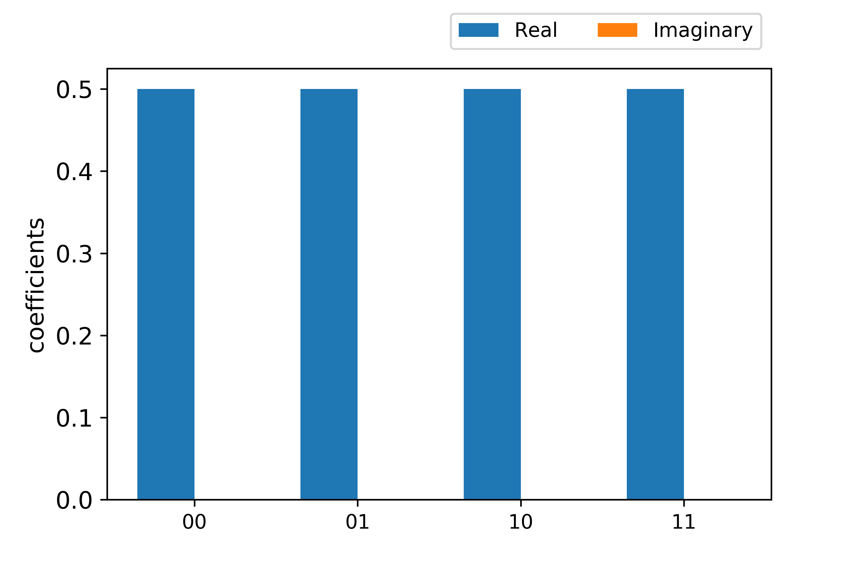
StateVector Change Process
Initialize StateVector

Slide 19
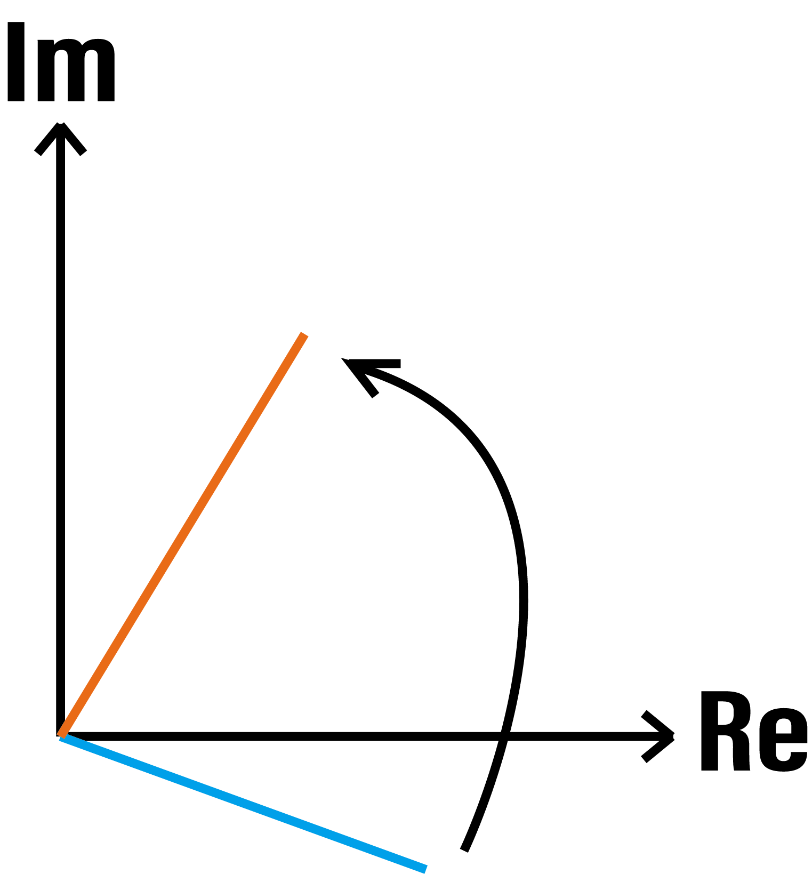
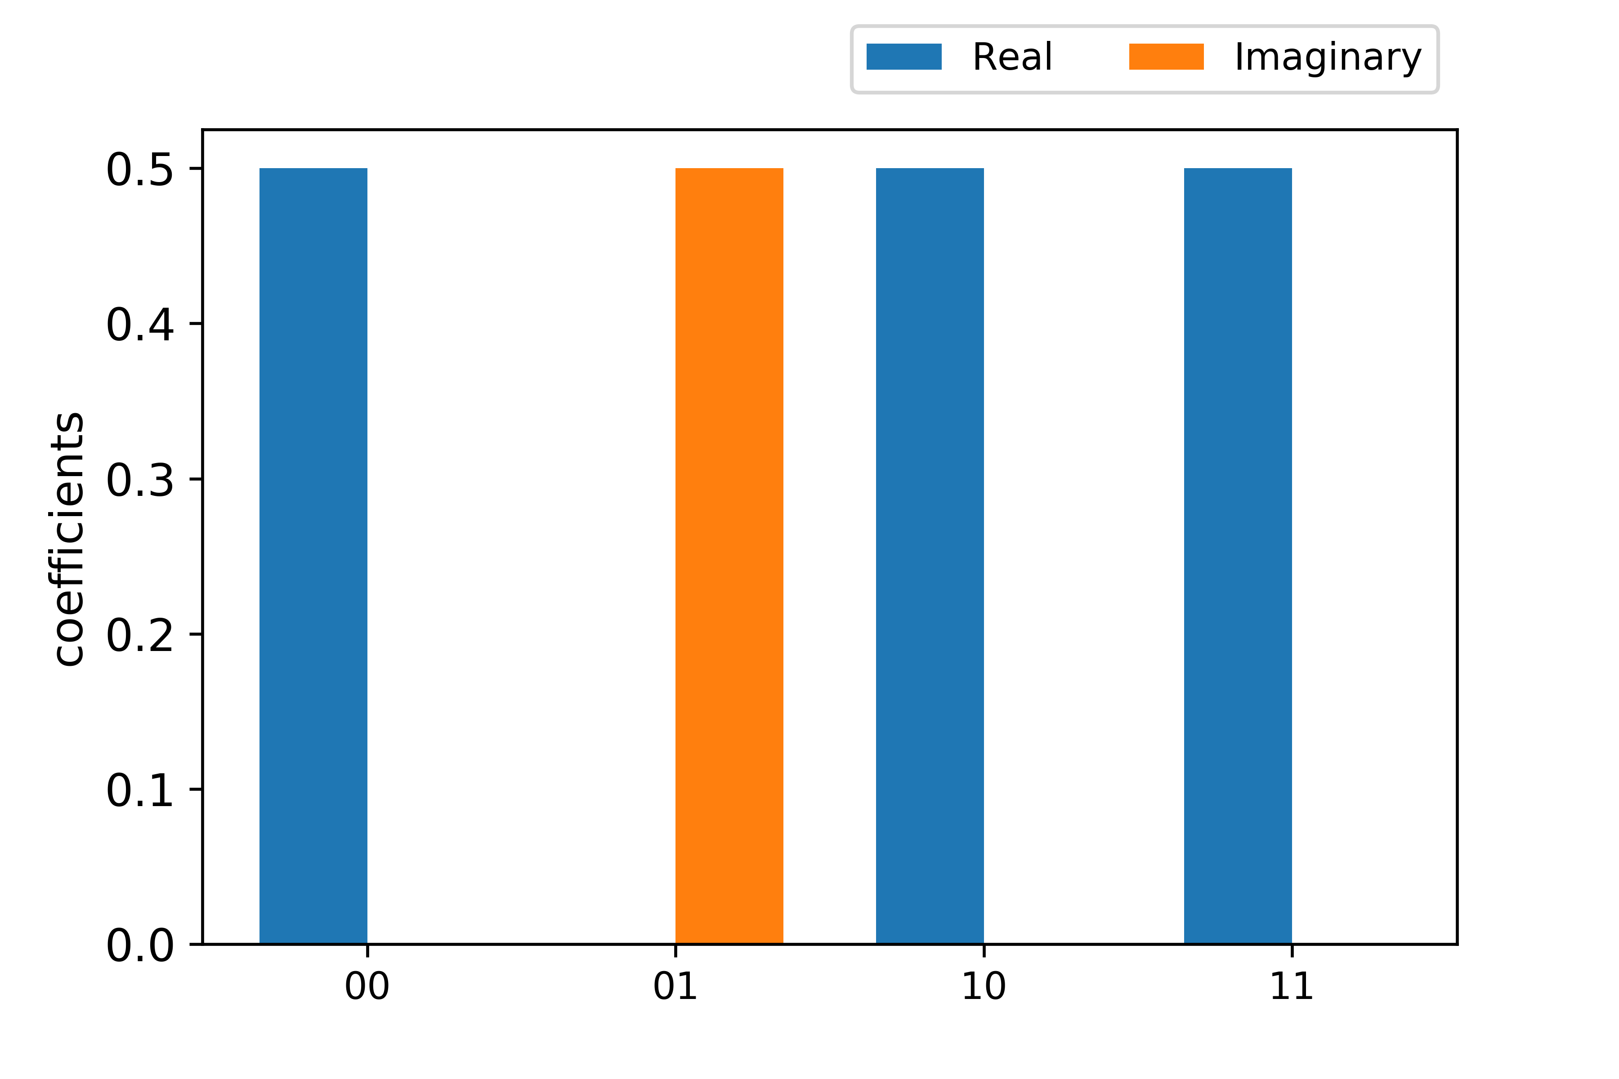
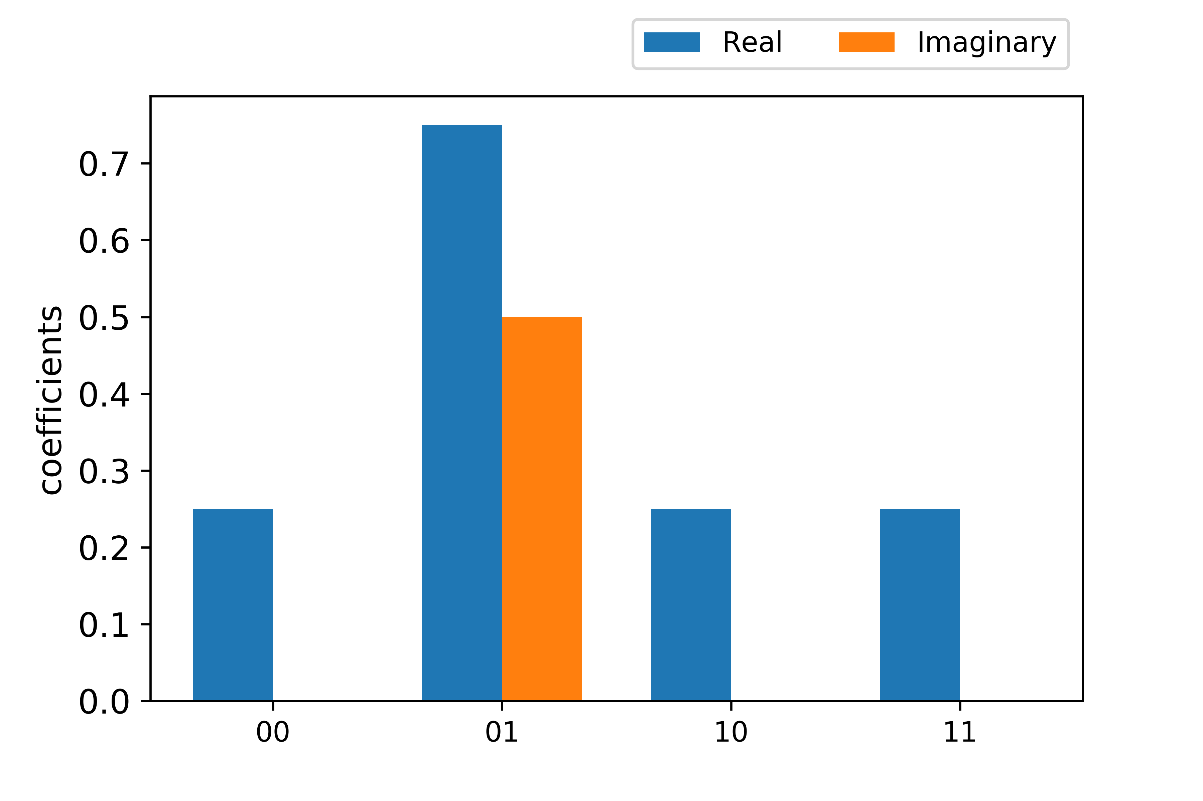
StateVector Change Process
StateVector after Oracle and U_Φ gate operation(First time)
U_Φ gate operations
After Oracle
After U_Φ gate

Slide 20
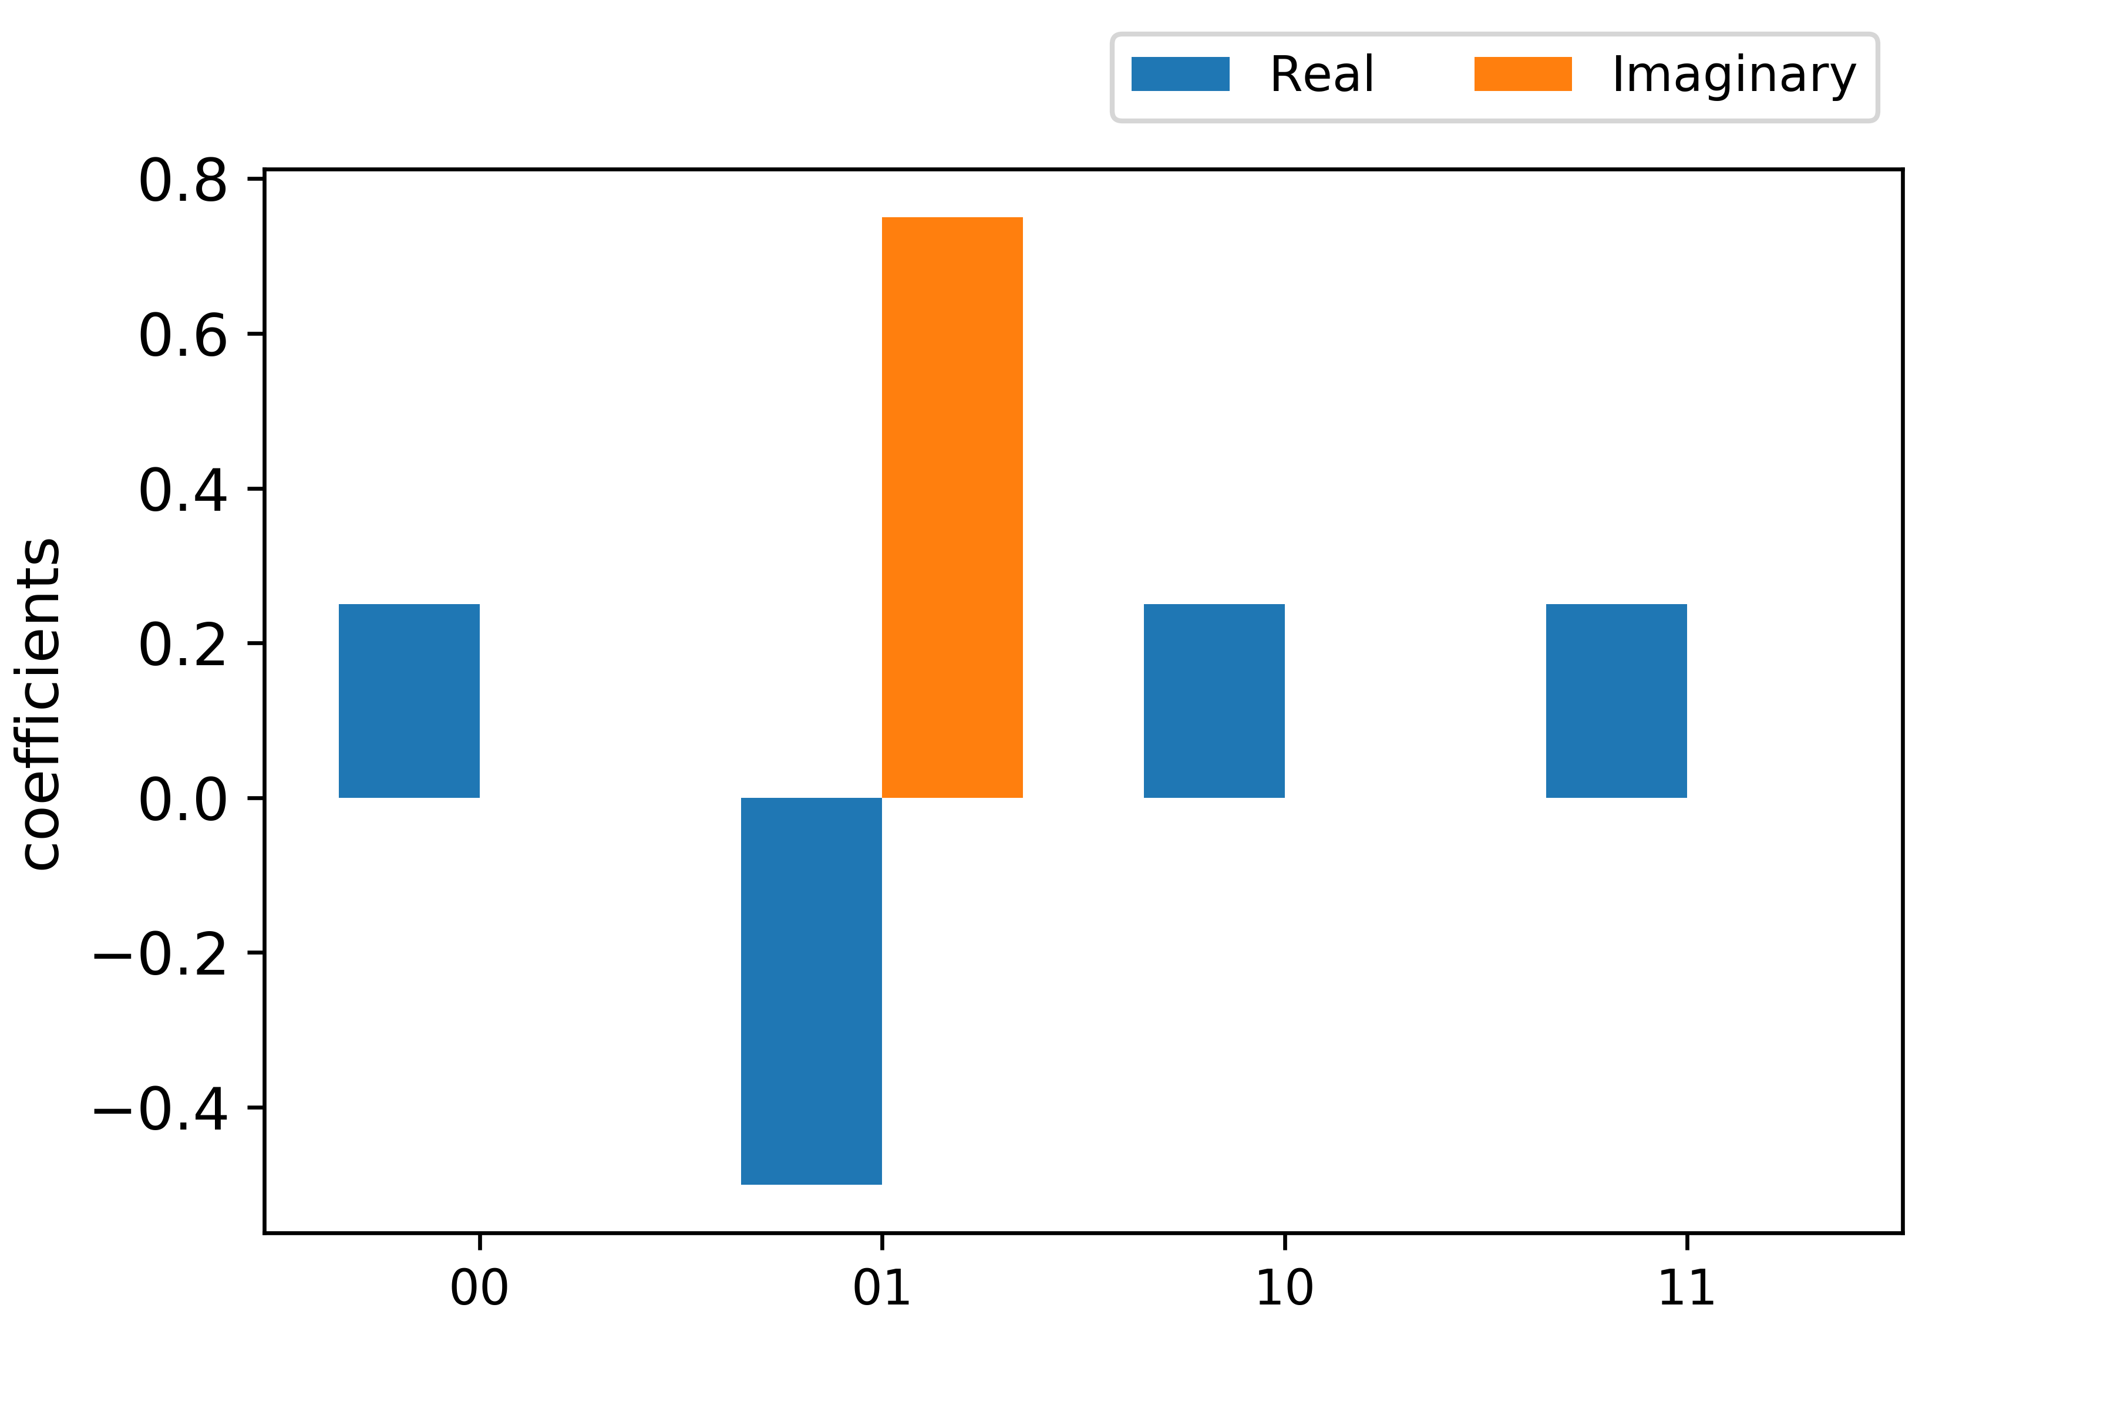
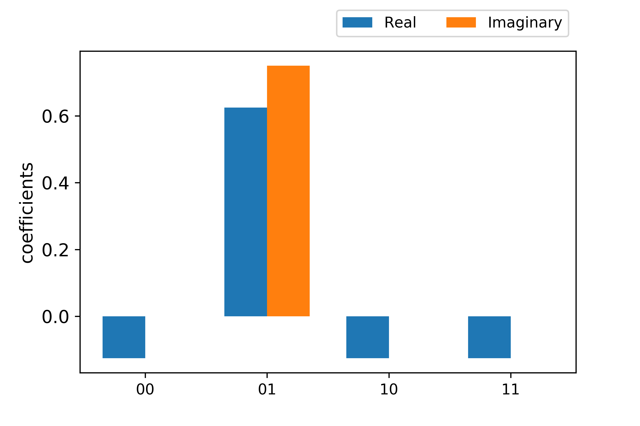
StateVector Change Process
StateVector after Oracle and U_Φ gate operation(Second time)
After Oracle
After U_Φ gate

Slide 21
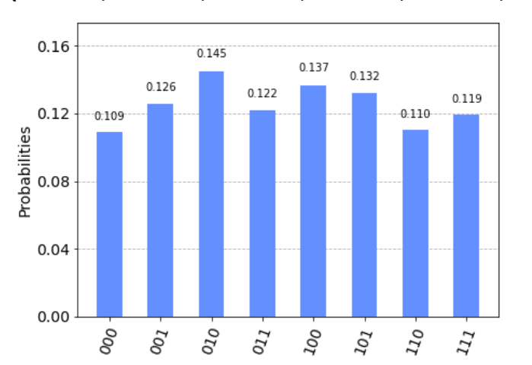
Pattern Matching Failed
Pattern String: TTAGTGGG
Find:
AAG

Slide 22
Reference
Raffaele Palmieri. “Implementation and testing of current quantum pattern matching algorithms applied to genomic sequencing.”, Rel.Bartolomeo Morntrucchio. Politecnico di Torino, Corso di laurea magistrale in Ingegneria Informatica (Computer Engineering), 2019.
Ventura D., Martinez T. “A Quantum Associative Memory Based on Grover’s Algorithm.”, In: Artificial Neural Nets and Genetic Algorithms. Springer, Vienna. https://doi.org/10.1007/978-3-7091-6384-9_5, 1999.
Ventura, D., Martinez, T. “Initializing the Amplitude Distribution of a Quantum State.” Found Phys Lett 12, 547–559. https://doi.org/10.1023/A:1021695125245, 1999.
Montanaro, “A. Quantum Pattern Matching Fast on “Average. Algorithmica 77, 16–39. https://doi.org/10.1007/s00453-015-0060-4, 2017.

